Slide 1

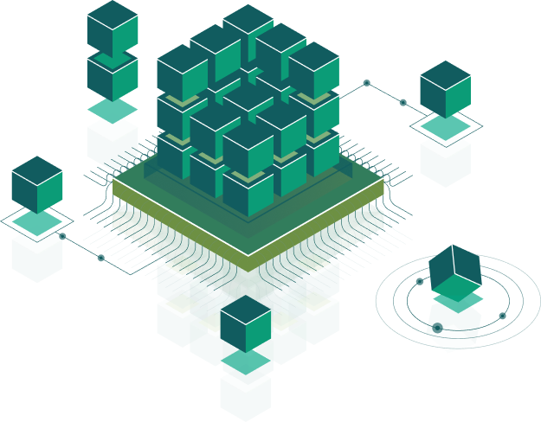
User Interface
Speaker:
Andrii Rudyk

Slide 2
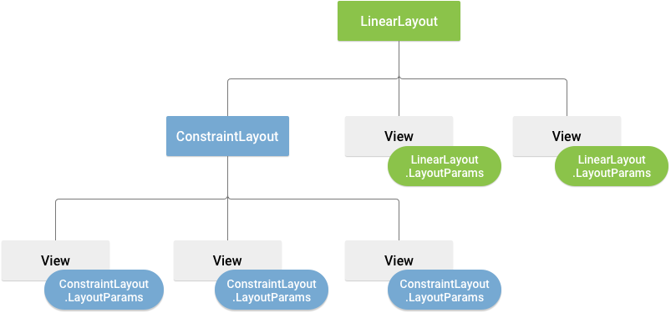
UI Layouts
A View occupies a rectangular area on the screen and is responsible for drawing and event handling.The View class is a superclass for all GUI components in Android

Slide 3
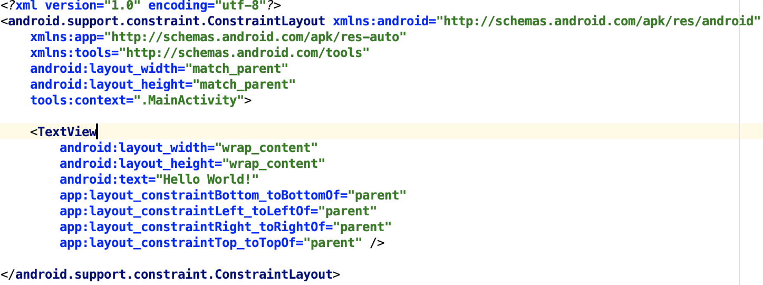
Layout file
Android activities define their user interface with views (widgets) and fragments. This user interface can be defined via XML layout resource files in the /res/layout folder or via Java code. You can also mix both approaches.

Slide 4
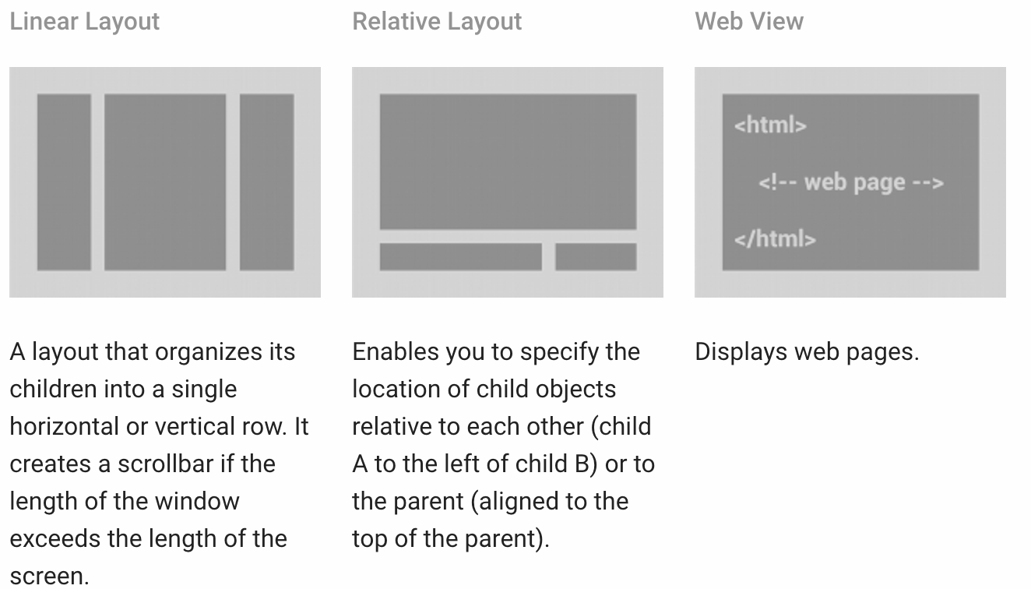
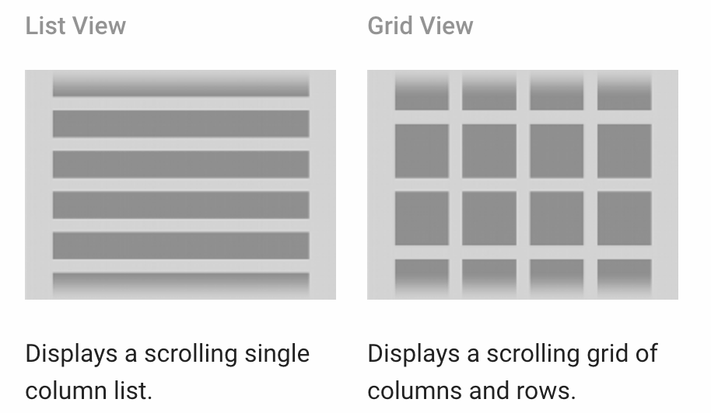
Android Layout Types
Android activities define their user interface with views (widgets) and fragments. This user interface can be defined via XML layout resource files in the /res/layout folder or via Java code. You can also mix both approaches.

Slide 5


LinearLayout
LinearLayout is a view group that aligns all children in a single direction, vertically or horizontally. You can specify the layout direction with the android:orientation attribute.

Slide 6
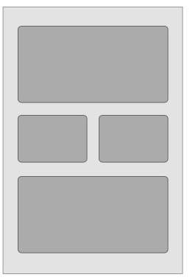
RelativeLayout
RelativeLayout is a view group that displays child views in relative positions. The position of each view can be specified as relative to sibling elements (such as to the left-of or below another view) or in positions relative to the parent RelativeLayout area (such as aligned to the bottom, left or center).

Slide 7
FrameLayout, GridLayout
FrameLayout is designed to block out an area on the screen to display a single item. Generally, FrameLayout should be used to hold a single child view, because it can be difficult to organize child views in a way that's scalable to different screen sizes without the children overlapping each other.
The grid is composed of a set of infinitely thin lines that separate the viewing area into cells. Throughout the API, grid lines are referenced by grid indices.

Slide 8
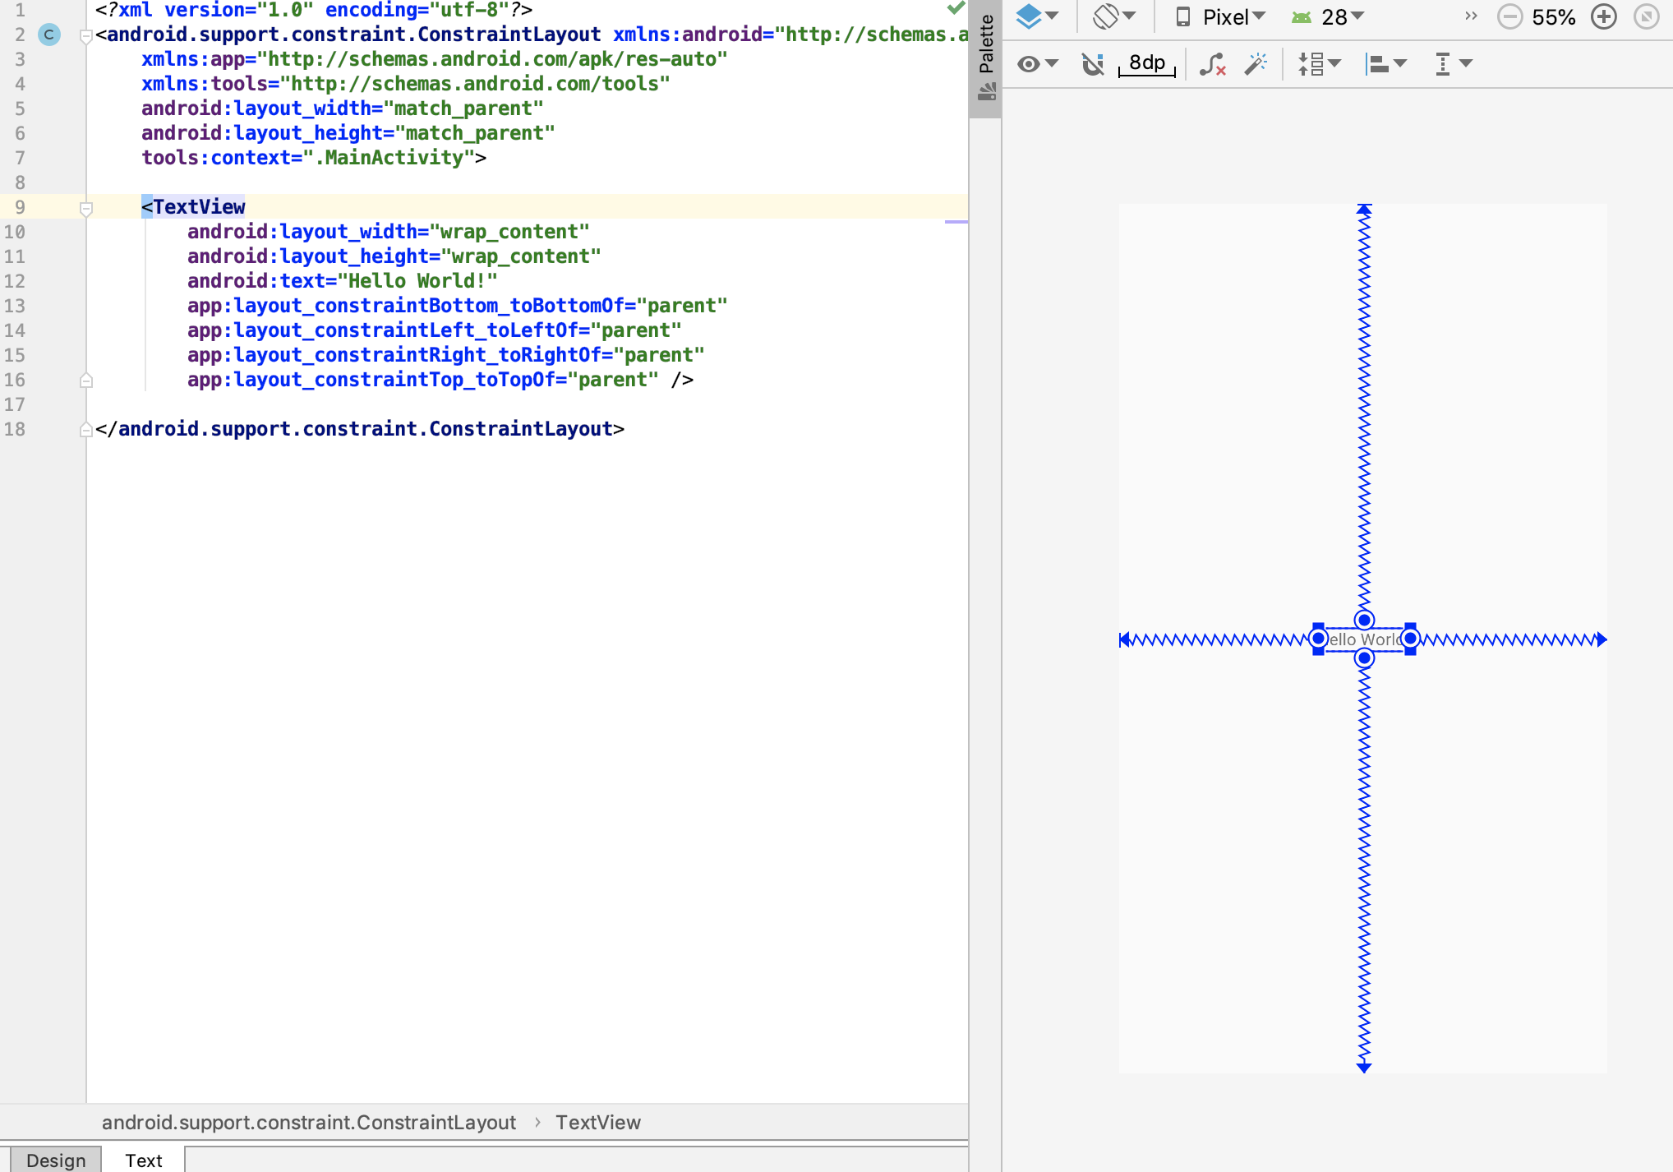
ConstraintLayout
ConstraintLayout is provided by an external library. It allows you to use a flat view hierarchy and has great performance. Also the design tools support constraint layout very well.

Slide 9
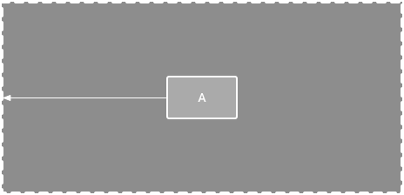
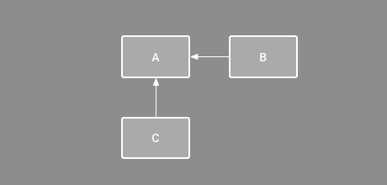
ConstraintLayout
Parent position - constrain the side of a view to the corresponding edge of the layout.
Order position - define the order of appearance for two views, either vertically or horizontally.

Slide 10
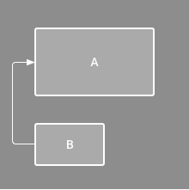
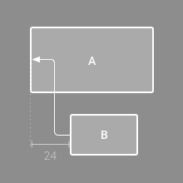
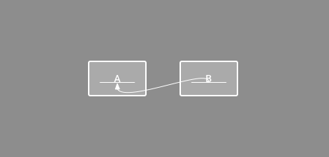
ConstraintLayout
Align the edge of a view to the same edge of another view.
Baseline alignment - align the text baseline of a view to the text baseline of another view.

Slide 11
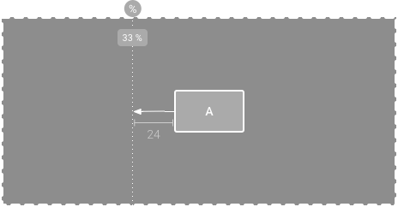
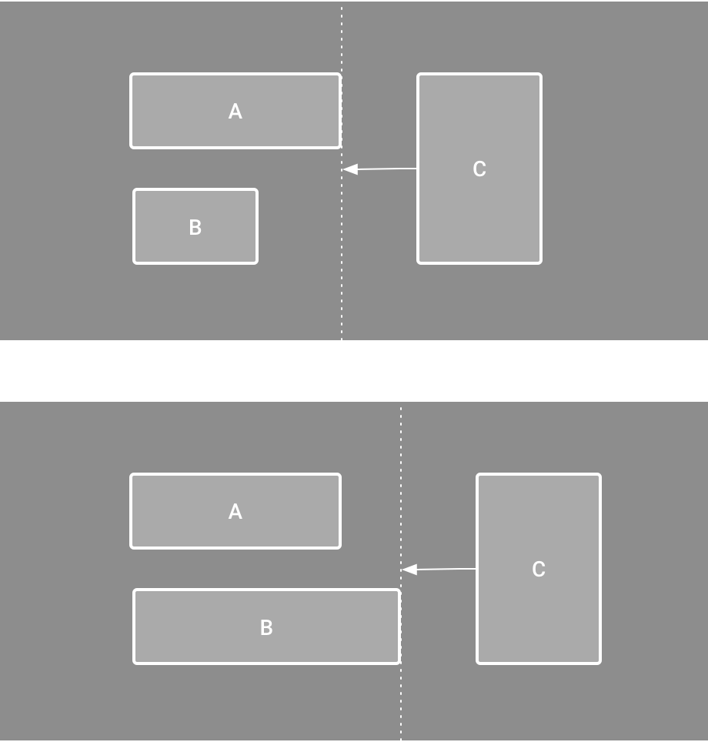
ConstraintLayout
Constrain to a guideline - add a vertical or horizontal guideline to which you can constrain views, and the guideline will be invisible to app users.
Constrain to a barrier - similar to a guideline, a barrier is an invisible line that you can constrain views to.

Slide 12
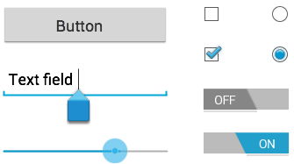
UI Controls (Textview, EditText, Radio Button, Checkbox)
In android ui or input controls are the interactive or View components which are used to design the user interface of an application. In android we have a wide variety of UI or input controls available, those are TextView, EditText, Buttons, Checkbox, Progressbar, Spinners, etc. Generally, in android the user interface of an app is made with a collection of View and ViewGroup objects.

Slide 13
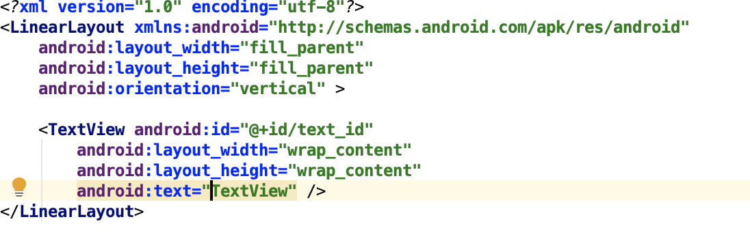
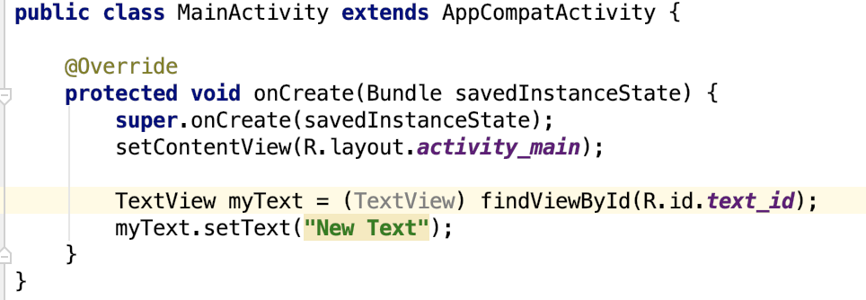
Declare UI Elements in XML
Input controls are the interactive components in your app's user interface. Android provides a wide variety of controls you can use in your UI, such as buttons, text fields, seek bars, check box, zoom buttons, toggle buttons, and many more.

Slide 14
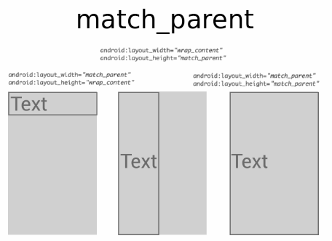
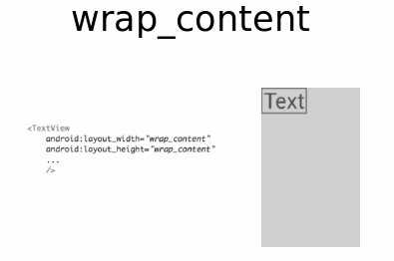
Layout Attributes
Each layout has a set of attributes which define the visual properties of that layout. There are few common attributes among all the layouts and their are other attributes which are specific to that layout.

Slide 15

Event Handling
Events are a useful way to collect data about a user's interaction with interactive components of Applications.
Event Listener − an interface in the View class that contains a single callback method. These methods will be called by the Android framework when the View to which the listener has been registered is triggered by user interaction with the item in the UI.
Event Listeners Registration − the process by which an Event Handler gets registered with an Event Listener so that the handler is called when the Event Listener fires the event.
Event Handler − when an event happens and we have registered an event listener for the event, the event listener calls the Event Handlers, which is the method that actually handles the event.

Slide 16
Event listeners
onClick() - From View.OnClickListener. When touch the item.
onLongClick() - From View.OnLongClickListener. When touch and holds the item
onFocusChange() - From View.OnFocusChangeListener. When navigate onto or away from the item
onKey() - From View.OnKeyListener. When focus on the item and presses or releases a hardware key on the device
onTouch() - From View.OnTouchListener. When perform an action qualified as a touch event

Slide 17
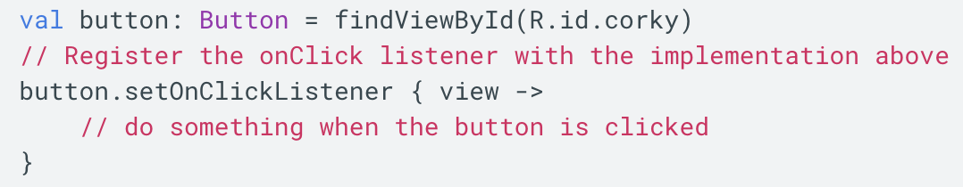
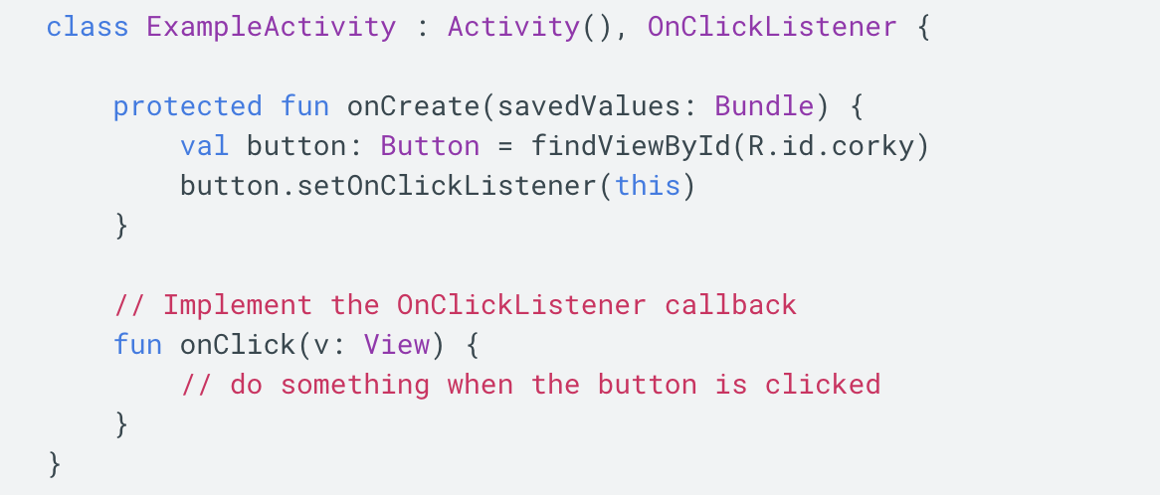
Event Listeners Registration

Slide 18
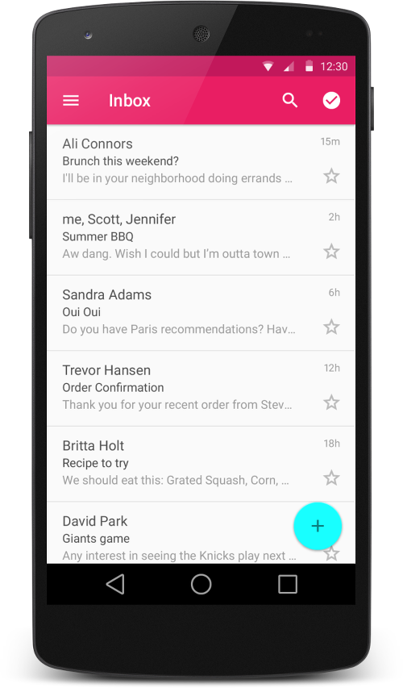
RecyclerView
The RecyclerView is a new ViewGroup that is prepared to render any adapter-based view in a similar way. It is supposed to be the successor of ListView and GridView, and it can be found in the latest support-v7 version.
RecyclerView Features:
ViewHolder to store data that makes binding view contents easier
ItemDecorator to set special drawing and layout offset
SmoothScroller for smooth scrolling
LayoutManager
By Default Animations while adding or removing an item

Slide 19
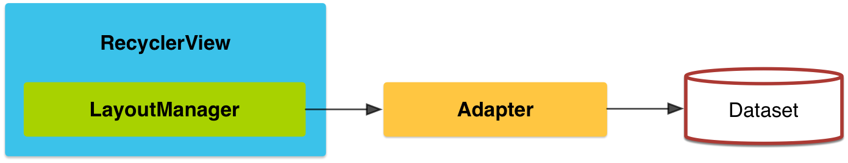
RecyclerView - Overview
If you want to use a RecyclerView, you will need to work with the following:
RecyclerView.Adapter - To handle the data collection and bind it to the view
LayoutManager - Helps in positioning the items
ItemAnimator - Helps with animating the items for common operations such as Addition or Removal of item

Slide 20
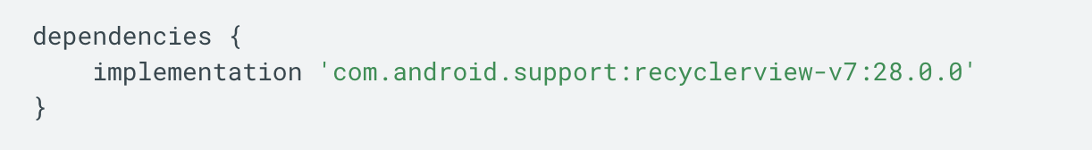
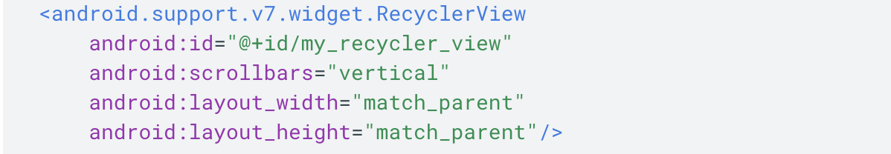
RecyclerView - Dependencies
To access the RecyclerView widget, you need to add the v7 Support Libraries to your project as follows:
Open the build.gradle file for your app module.
Add the support library to the dependencies section.
Add RecyclerView to your layout

Slide 21
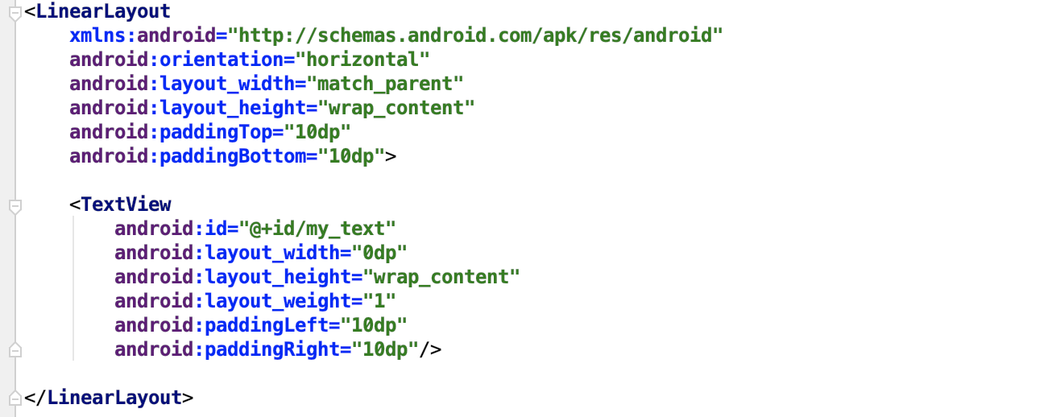
RecyclerView - Item

Slide 22
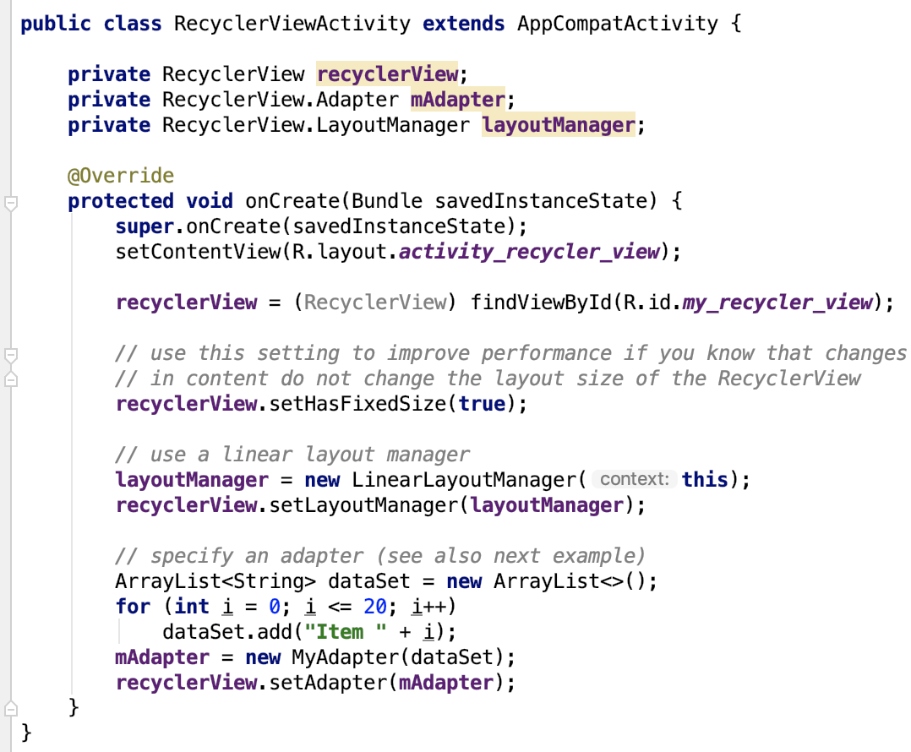
RecyclerView - Activity

Slide 23
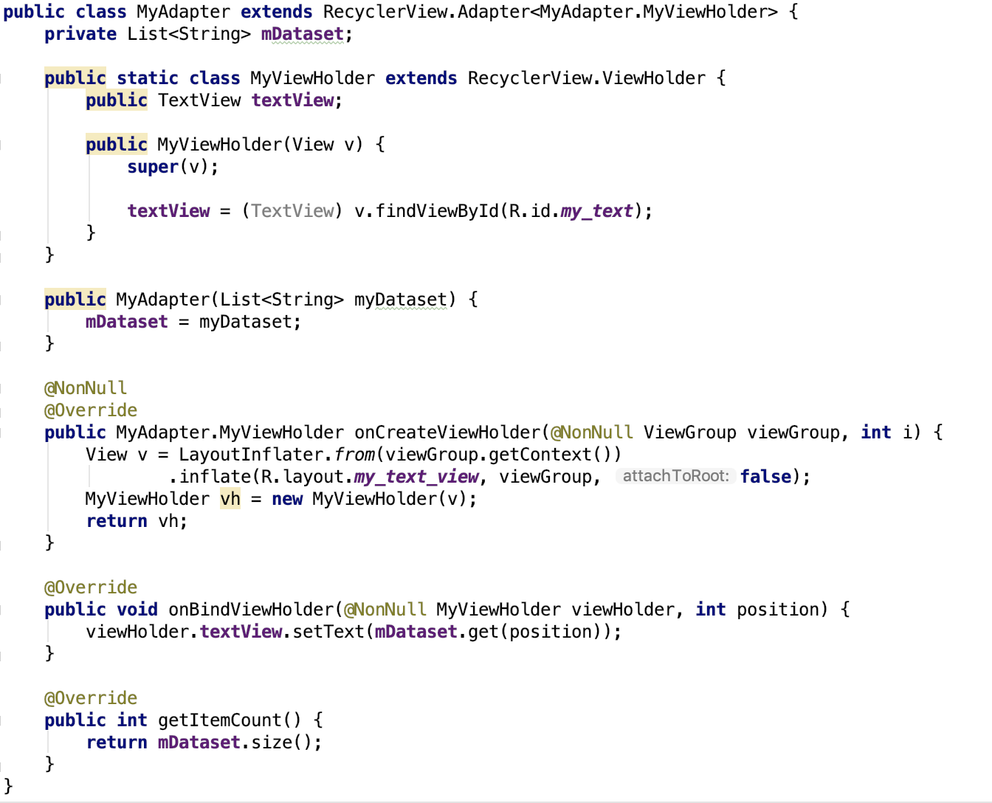
RecyclerView - Adapter

Slide 24
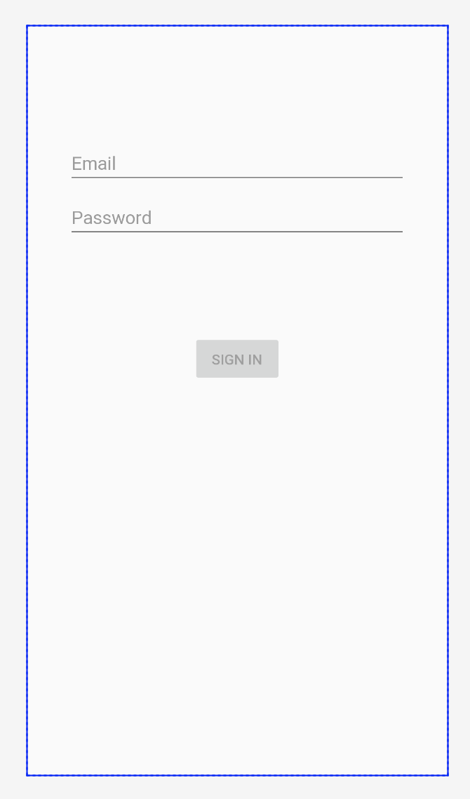
Create Login Screen

Slide 25

Thank you!
Notes:
Apk image sizes
App priority

